Slide 1
Workshop 1
Chris’s Solution

Slide 2
Basic Idea
Re-use the code that we already have from class to construct a new program
Look for something structural on the webpage that we can exploit when doing a regex search
Pull out the structural matches and process with a second set of regexes

Slide 3
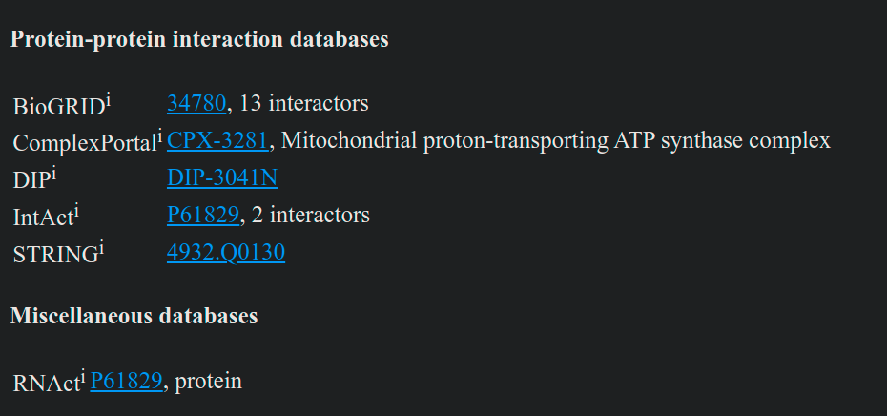
Exploratory regexes
We notice that the database entries seem to be under headers using the word “databases”
We also notice that each database name seems to have a superscript “i”
So, let’s try the regex ‘databases’
A section of the webpage containing database IDs

Slide 4
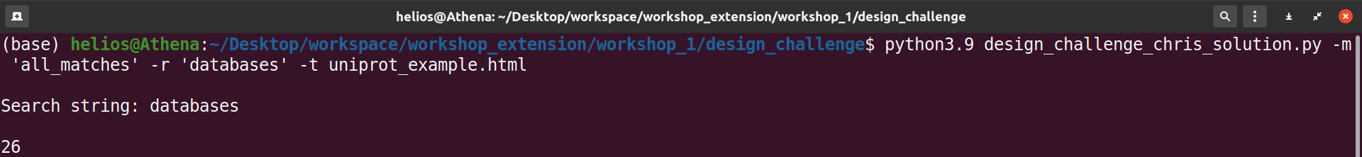
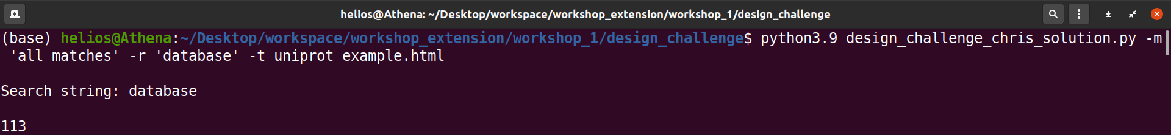
Exploratory regexes
With this search, we get 26 results from the page…
…while with this search, we get 113 results from the page

Slide 5
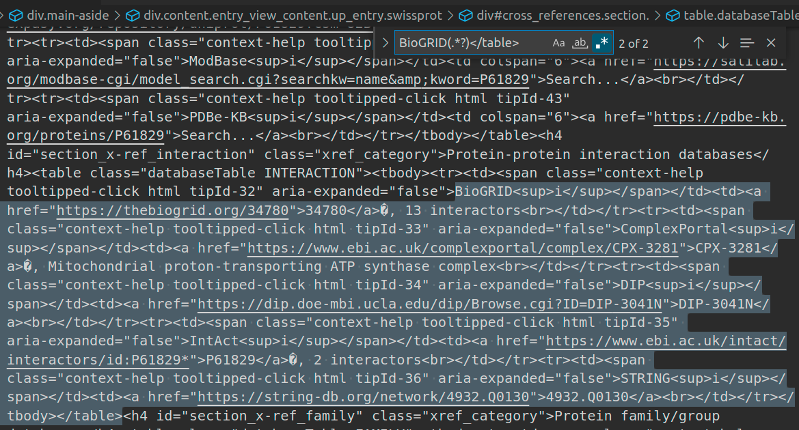
Exploratory regexes
A regex search in VS Code reveals that the database name and ID fall within a <table>…</table> structure

Slide 6
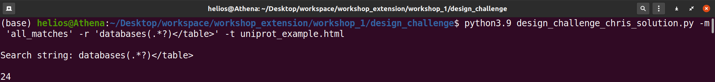
Exploratory regexes*
With this search, we get 24 results from the page…not bad, but we may have lost 2 results with this regex compared to the ‘databases’ regex…
…we’ll proceed with this one, however, as it catches most of what we need…
* Note that the regex (.*?) means “match anything” – VERY useful

Slide 7
Final steps (second regexes)
Re-visit the fact that each database seems to have a <sup>i</sup> tag next to its name
Since the database name and IDs are <table>…</table>-structured, we can look for nearby <a>…</a> tags (these are the links to the database IDs)
See the next slide for some logic taken from my solution…
A section of the webpage containing database IDs

Slide 8
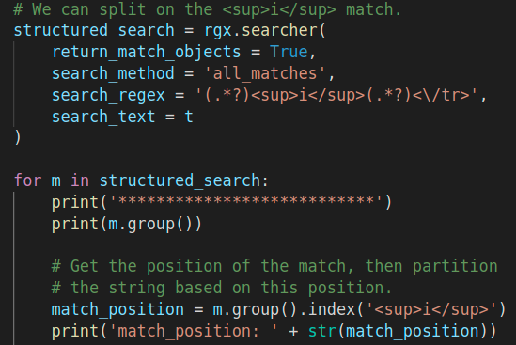
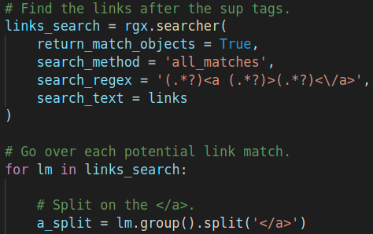
Final steps (second regexes)
…then get the <a>…</a> links…
Look for the <sup>…</sup> matches…

Slide 9
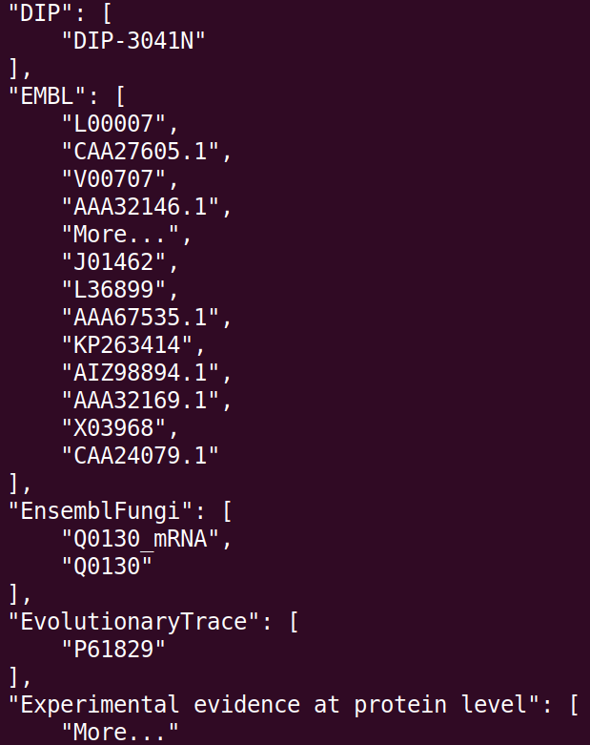
Exploratory regexes
Some final results…a few false positives, but not bad for a first script…

Slide 10
Closing thoughts
Why couldn’t we have used the regex ‘<\/span> (.*?)<sup>’
Why couldn’t we have used the regex ‘(.*?)<sup>i</sup>(.*?)<\/tr>’
A much simpler solution to parse the information on a well-structured web page is to use a tag parsing module (e.g. xmltodict)…
…however, MANY webpages are of inferior quality and not good enough to use such modules

